Slide 1
CHAPTER 19
INTRODUCTION TO FUZZY LOGIC TOOLBOX IN MATLAB
“Principles of Soft Computing, 2nd Edition”
by S.N. Sivanandam & SN Deepa
Copyright © 2011 Wiley India Pvt. Ltd. All rights reserved.

Slide 2
FUZZY LOGIC TOOLBOX
Fuzzy logic in Matlab can be dealt very easily due to the existing new Fuzzy Logic Toolbox.
This provides a complete set of functions to design an implement various fuzzy logic processes.
The major fuzzy logic operations include:
        fuzzification,
        defuzzification,
        fuzzy inference.
These all are performed by means of various functions and even can be implemented using the Graphical User Interface.
“Principles of Soft Computing, 2nd Edition”
by S.N. Sivanandam & SN Deepa
Copyright © 2011 Wiley India Pvt. Ltd. All rights reserved.

Slide 3
The features are:
It provides tools to create and edit Fuzzy Inference Systems (FIS). It allows integrating fuzzy systems into simulation with SIMULINK.
It is possible to create stand-alone C programs that call on fuzzy systems built with MATLAB.
The Toolbox provides three categories of tools:
        Command line functions,
        Graphical or interactive tools,
        Simulink blocks.
“Principles of Soft Computing, 2nd Edition”
by S.N. Sivanandam & SN Deepa
Copyright © 2011 Wiley India Pvt. Ltd. All rights reserved.

Slide 4
COMMAND LINE FIS FUNCTIONS
Addmf - Add membership function to FIS
addrule - Add rule to FIS.
addvar - Add variable to FIS.
defuzz - Defuzzify membership function.
evalfis - Perform fuzzy inference calculation
evalmf - Generic membership function evaluation.
gensurf - Generate FIS output surface.
getfis - Get fuzzy system properties.
mfstrtch - Stretch membership function.
newfis - Create new FIS.
plotfis - Display FIS input-output diagram.
plotmf - Display all membership functions for one variable.
readfis - Load FIS from disk.
rmmf - Remove membership function from FIS
rmvar - Remove variable from FIS.
Setfis - Set fuzzy system properties.
showfis - Display annotated FIS.
Showrule - Display FIS rules
writefis - Save FIS to disk.
“Principles of Soft Computing, 2nd Edition”
by S.N. Sivanandam & SN Deepa
Copyright © 2011 Wiley India Pvt. Ltd. All rights reserved.

Slide 5
MEMBERSHIP FUNCTIONS
Dsigmf - Difference of two sigmoid membership functions.
gauss2mf - Two-sided Gaussian curve membership function.
gaussmf - Gaussian curve membership function.
gbellmf - Generalized bell curve membership function.
pimf - Pi-shaped curve membership function.
psigmf - Product of two sigmoid membership functions.
smf - S-shaped curve membership function.
sigmf - Sigmoid curve membership function.
trapmf - Trapezoidal membership function.
trimf - Triangular membership function.
zmf - Z-shaped curve membership function.
“Principles of Soft Computing, 2nd Edition”
by S.N. Sivanandam & SN Deepa
Copyright © 2011 Wiley India Pvt. Ltd. All rights reserved.

Slide 6
GRAPHICAL USER INTERFACE EDITORS (GUI TOOLS)
anfisedit - ANFIS training and testing UI tool.
findcluster - Clustering UI tool.
fuzzy - Basic FIS editor.
mfedit - Membership function editor.
ruleedit - Rule editor and parser.
ruleview - Rule viewer and fuzzy inference diagram.
surfview - Output surface viewer.
“Principles of Soft Computing, 2nd Edition”
by S.N. Sivanandam & SN Deepa
Copyright © 2011 Wiley India Pvt. Ltd. All rights reserved.

Slide 7
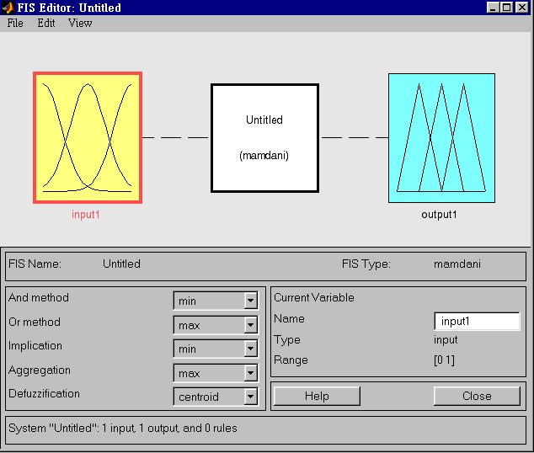
FIS EDITOR (MAMDANI)
“Principles of Soft Computing, 2nd Edition”
by S.N. Sivanandam & SN Deepa
Copyright © 2011 Wiley India Pvt. Ltd. All rights reserved.

Slide 8
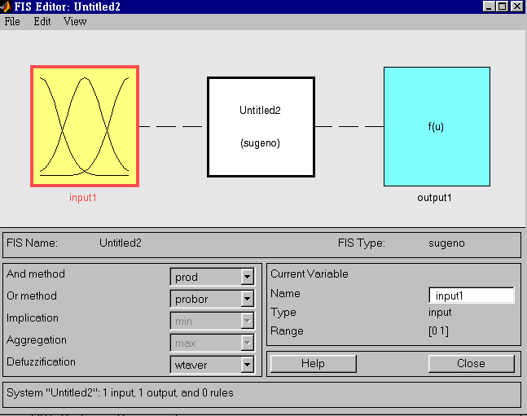
FIS EDITOR (SUGENO)
“Principles of Soft Computing, 2nd Edition”
by S.N. Sivanandam & SN Deepa
Copyright © 2011 Wiley India Pvt. Ltd. All rights reserved.

Slide 9
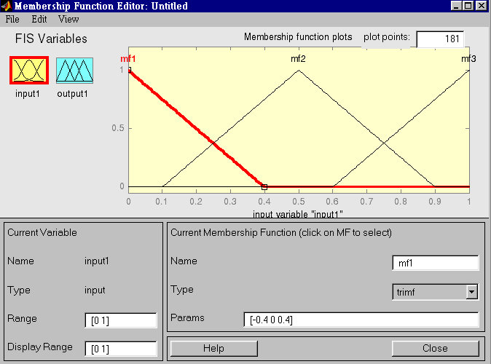
FIS MEMBERSHIP FUNCTION EDITOR
“Principles of Soft Computing, 2nd Edition”
by S.N. Sivanandam & SN Deepa
Copyright © 2011 Wiley India Pvt. Ltd. All rights reserved.

Slide 10
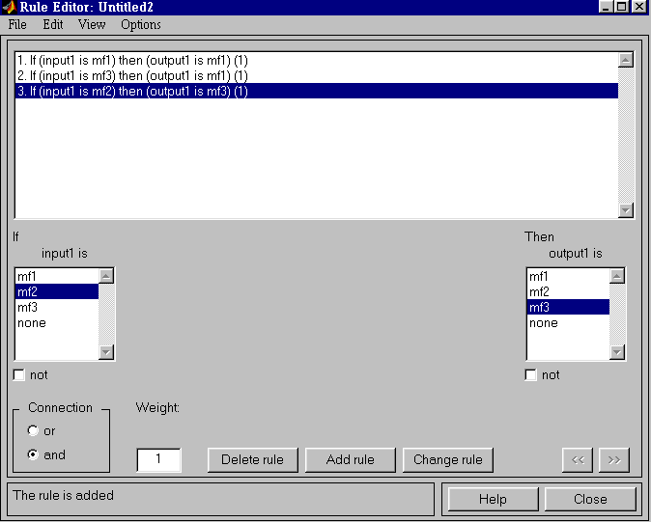
FIS RULE EDITOR
“Principles of Soft Computing, 2nd Edition”
by S.N. Sivanandam & SN Deepa
Copyright © 2011 Wiley India Pvt. Ltd. All rights reserved.

Slide 11
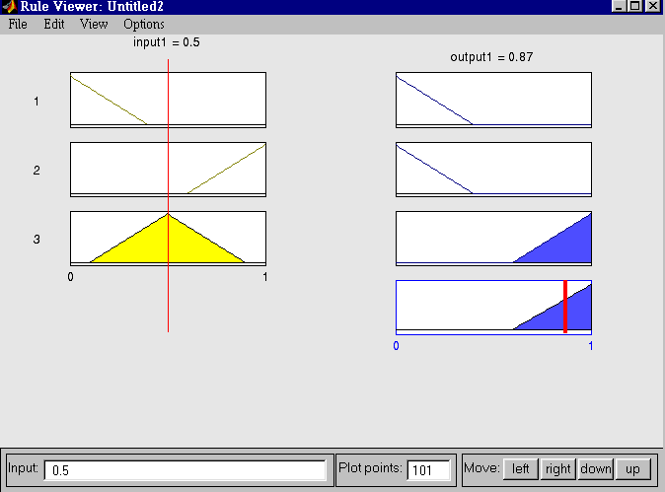
FIS RULE VIEWER
“Principles of Soft Computing, 2nd Edition”
by S.N. Sivanandam & SN Deepa
Copyright © 2011 Wiley India Pvt. Ltd. All rights reserved.

Slide 12
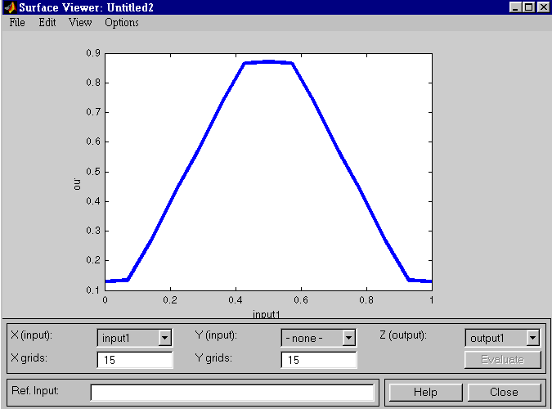
FIS SURFACE VIEWER
“Principles of Soft Computing, 2nd Edition”
by S.N. Sivanandam & SN Deepa
Copyright © 2011 Wiley India Pvt. Ltd. All rights reserved.

Slide 13
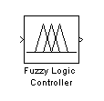
SIMULINK BLOCKS
Once fuzzy system is created using GUI tools or some other method, can be directly embedded into SIMULINK using the Fuzzy Logic Controller block.
“Principles of Soft Computing, 2nd Edition”
by S.N. Sivanandam & SN Deepa
Copyright © 2011 Wiley India Pvt. Ltd. All rights reserved.

Slide 14
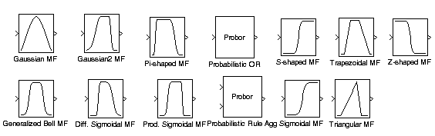
MEMBERSHIP SIMULINK BLOCKS
This Toolbox includes 11 built-in membership function types, built from several basic functions: piecewise linear functions (triangular and trapezoidal), the Gaussian distribution function (gaussian curves and generalized bell), the sigmoid curve, and quadratic and cubic polynomial curves (Z, S, and Pi curves).
“Principles of Soft Computing, 2nd Edition”
by S.N. Sivanandam & SN Deepa
Copyright © 2011 Wiley India Pvt. Ltd. All rights reserved.

Slide 15
ADVANCED TECHNIQUES
anfis - Training routine for Sugeno-type FIS (MEX only).
fcm - Find clusters with fuzzy c-means clustering.
genfis1 - Generate FIS matrix using generic method.
genfis2 - Generate FIS matrix using subtractive clustering.
subclust - Estimate cluster centers with subtractive clustering.
“Principles of Soft Computing, 2nd Edition”
by S.N. Sivanandam & SN Deepa
Copyright © 2011 Wiley India Pvt. Ltd. All rights reserved.

Slide 16
CONCLUSION
The presentation has given an overview of fuzzy logic toolbox in MATLAB.
“Principles of Soft Computing, 2nd Edition”
by S.N. Sivanandam & SN Deepa
Copyright © 2011 Wiley India Pvt. Ltd. All rights reserved.

